Slide 1

K J COLLEGE OF ENGINEERING AND MANAGEMENT RESEARCH, PUNE
Project On Soil Moisture Monitor System
Environment Studies
By:
Akshada Nandkumar Kambale

Slide 2
Introduction
Soil moisture monitoring has become an important part of modern agriculture and environmental studies due to increasing water scarcity and the need for efficient irrigation systems. Farmers often face difficulties in identifying the exact water requirement of soil, which can lead to overwatering or underwatering of crops. This not only affects plant growth but also results in wastage of water and reduced agricultural productivity.
To solve these problems, there is a need for a smart and efficient system that can monitor soil moisture levels in real time and help in proper water management. With the advancement of IoT and embedded systems, intelligent solutions can now be developed for sustainable agriculture and environmental protection.
This project introduces a Soil Moisture Monitoring System that uses sensor-based technology to detect the moisture content present in soil and provide accurate monitoring data. The system helps in efficient irrigation management, conserves water, improves crop health, and supports smart farming practices.

Slide 3
Literature Survey
Several existing agricultural monitoring systems use sensor-based technology to measure soil moisture levels and improve irrigation efficiency.
Research shows that soil moisture sensors are widely used for accurate and low-cost measurement of water content present in soil.
Many modern soil monitoring systems are based on IoT technology, enabling real-time monitoring, automatic irrigation control, and remote data access.
Some advanced systems also include temperature and humidity sensors to provide better analysis of environmental conditions for crop growth.
However, many existing solutions are expensive, complex, or difficult for small-scale farmers to implement on a large scale.
There is a need for a low-cost, efficient, and easy-to-use Soil Moisture Monitoring System, which this project aims to develop for smart and sustainable agriculture.

Slide 4
Problem Definition and Objectives
Problem Definition :
Improper irrigation and lack of soil monitoring can lead to poor crop growth and low agricultural productivity.
Overwatering and underwatering of crops result in wastage of water and damage to plants.
Farmers often do not have a real-time system to monitor soil moisture levels accurately.
Manual checking of soil conditions is time-consuming and inefficient.
There is a need for an automatic and efficient soil moisture monitoring system to support smart farming and water conservation.
Objectives :
Develop a Soil Moisture Monitoring System
Detect soil moisture level accurately
Provide real-time monitoring of soil conditions
Alert users when soil becomes too dry or too wet
Create a low-cost and scalable solution for agriculture
Support smart farming and water conservation
Reduce water wastage through efficient irrigation management
Make the system simple, reliable, and time efficient

Slide 5
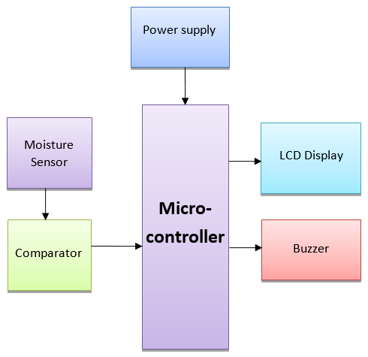
Block Diagram

Slide 6
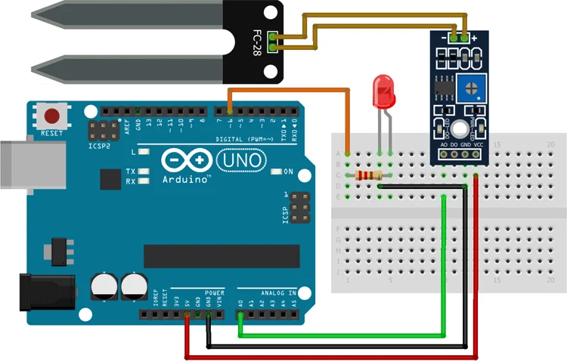
Circuit Diagram

Slide 7
Implementation Details
The system is built using an ESP8266 microcontroller as the main processing unit.
A soil moisture sensor is placed in the soil to measure the moisture content present in the soil.
The sensor continuously detects the moisture level and sends the data to the ESP8266 controller for processing.
The ESP8266 processes this data and converts it into readable moisture values. The data is displayed locally on an LCD display for user visibility.
A buzzer alert system can be activated when the soil becomes too dry, indicating the need for watering.
The ESP8266 sends real-time soil moisture data to a web-based dashboard using internet connectivity.
The entire system is powered by a battery or power supply, making it portable, efficient, and easy to use in agricultural fields and gardens.

Slide 8
Results
The system successfully detects soil moisture levels in real-time using a soil moisture sensor.
Accurate moisture readings are displayed on the LCD display.
The buzzer alert is triggered when the soil becomes too dry and requires watering.
Real-time soil moisture data is successfully updated on the web dashboard.
The system helps in efficient water management and prevents unnecessary water wastage.
The prototype demonstrates a cost-effective and efficient solution for smart agriculture.
Suitable for smart farming applications and scalable deployment in agricultural fields and gardens.

Slide 9
Conclusion
The Soil Moisture Monitoring System provides an efficient and intelligent solution for smart agriculture and water management.
It successfully monitors soil moisture levels using a soil moisture sensor and ESP8266 microcontroller.
The system ensures real-time monitoring through a web dashboard.
Proper irrigation management is achieved using a buzzer alert mechanism when the soil becomes dry.
The prototype is low-cost, reliable, and easy to implement.
It helps in water conservation and improves crop health and productivity.
The system supports the vision of smart farming and sustainable environmental development.

Slide 10
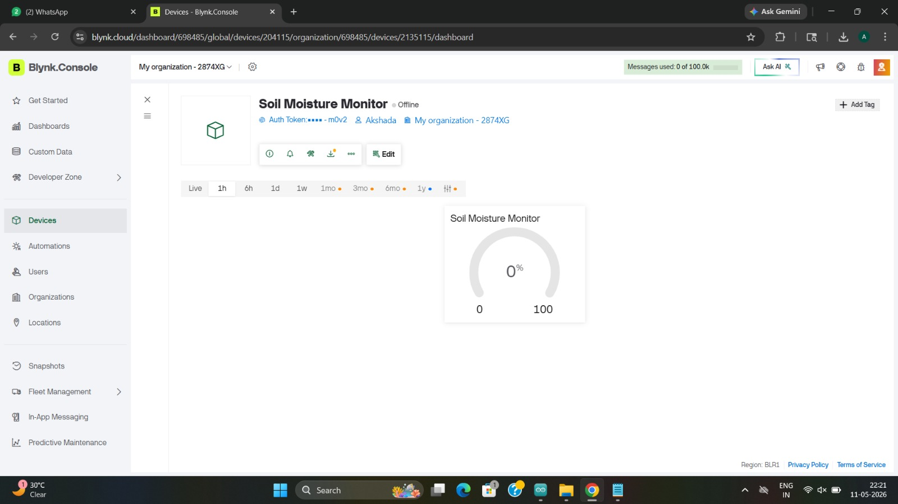
Home Page

Slide 11
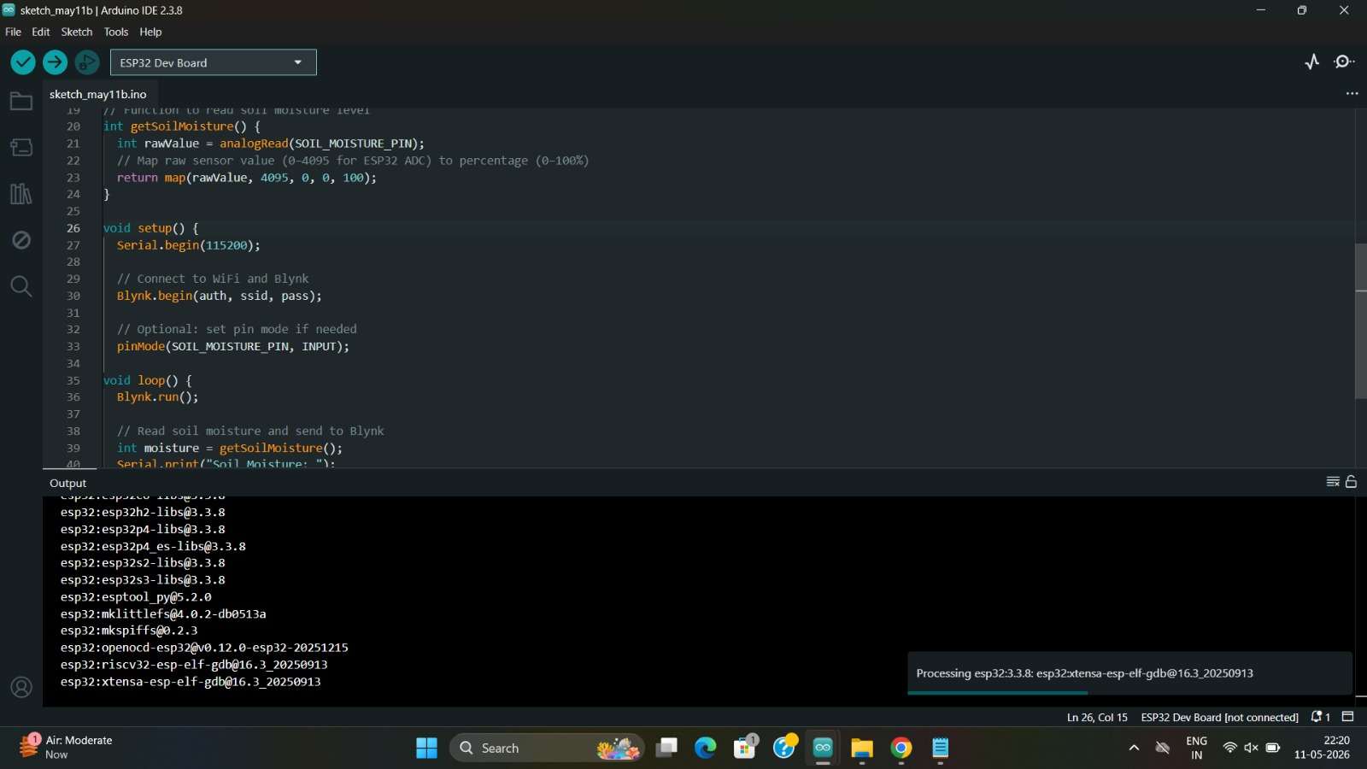
Program code

Slide 12
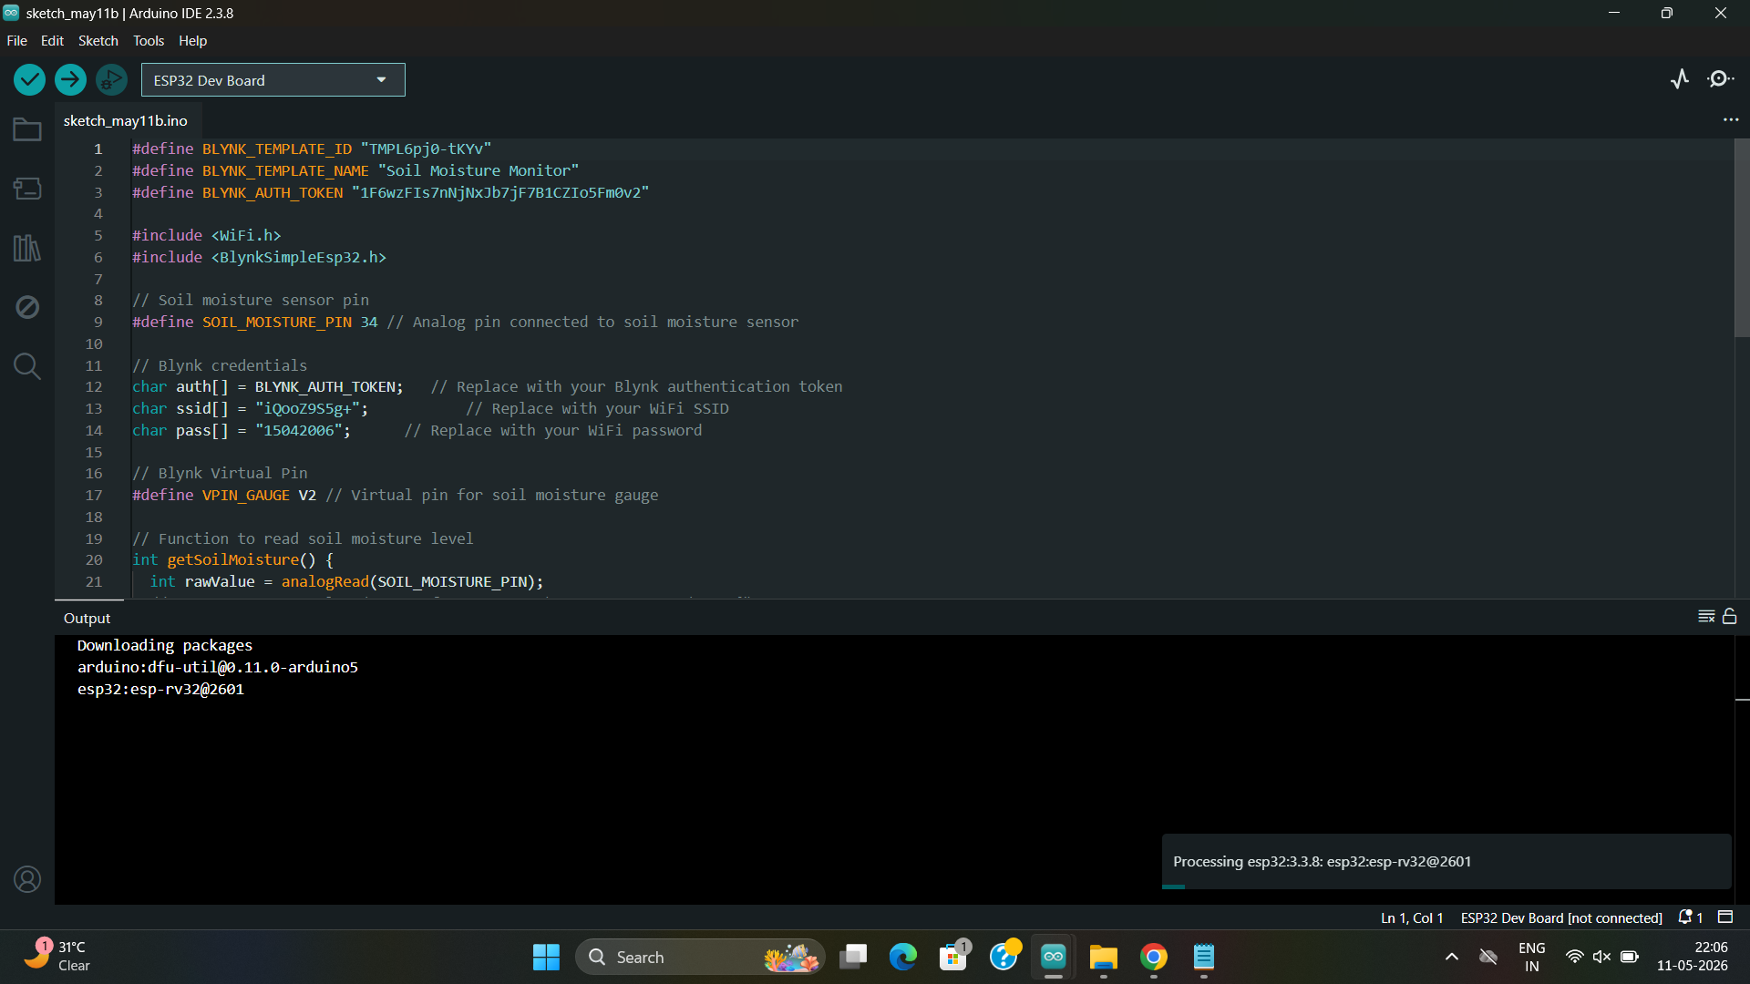

Slide 13
Applications
Smart Farming – Real-time monitoring of soil moisture levels
Agricultural Fields – Efficient irrigation management for crops
Gardens & Parks – Maintaining proper watering of plants
Greenhouses – Monitoring soil conditions for better plant growth
Research & Environmental Studies – Soil analysis and waterconservation studies Residential Areas – Smart gardening and lawn
maintenance Nurseries – Maintaining ideal moisture conditions for plants
Water Conservation Projects – Reducing unnecessary waterusage through smart monitoring

Slide 14
References
S. R. Nandurkar, V. R. Thool, and R. C. Thool, “Design and Development of Soil Moisture Monitoring System using IoT,” International Journal of Engineering Research and Technology (IJERT), 2020.
Espressif Systems, ESP8266 Technical Reference Manual, Version 1.7, 2020.
HandsOn Technology, Soil Moisture Sensor Datasheet, 2020.
A. Z. Misnan, N. A. Husin, and S. N. S. Yahya, Embedded Internet of Things (IoT) for Beginners, Pahang, Malaysia: Politeknik Muadzam Shah, 2024.
R. K. Kodali and S. Soratkal, “IoT Based Smart Irrigation System,” International Conference on Communication and Signal Processing, 2018.

